Slide 1
Lambda Function in Python
Anonymous Presenters

Slide 2
Introduction of Lambda
PART I

Slide 3
Lambda Function in Python
Lambda functions provide a concise way to create:
small, anonymous functions
without needing to define a formal function using def.

Slide 4
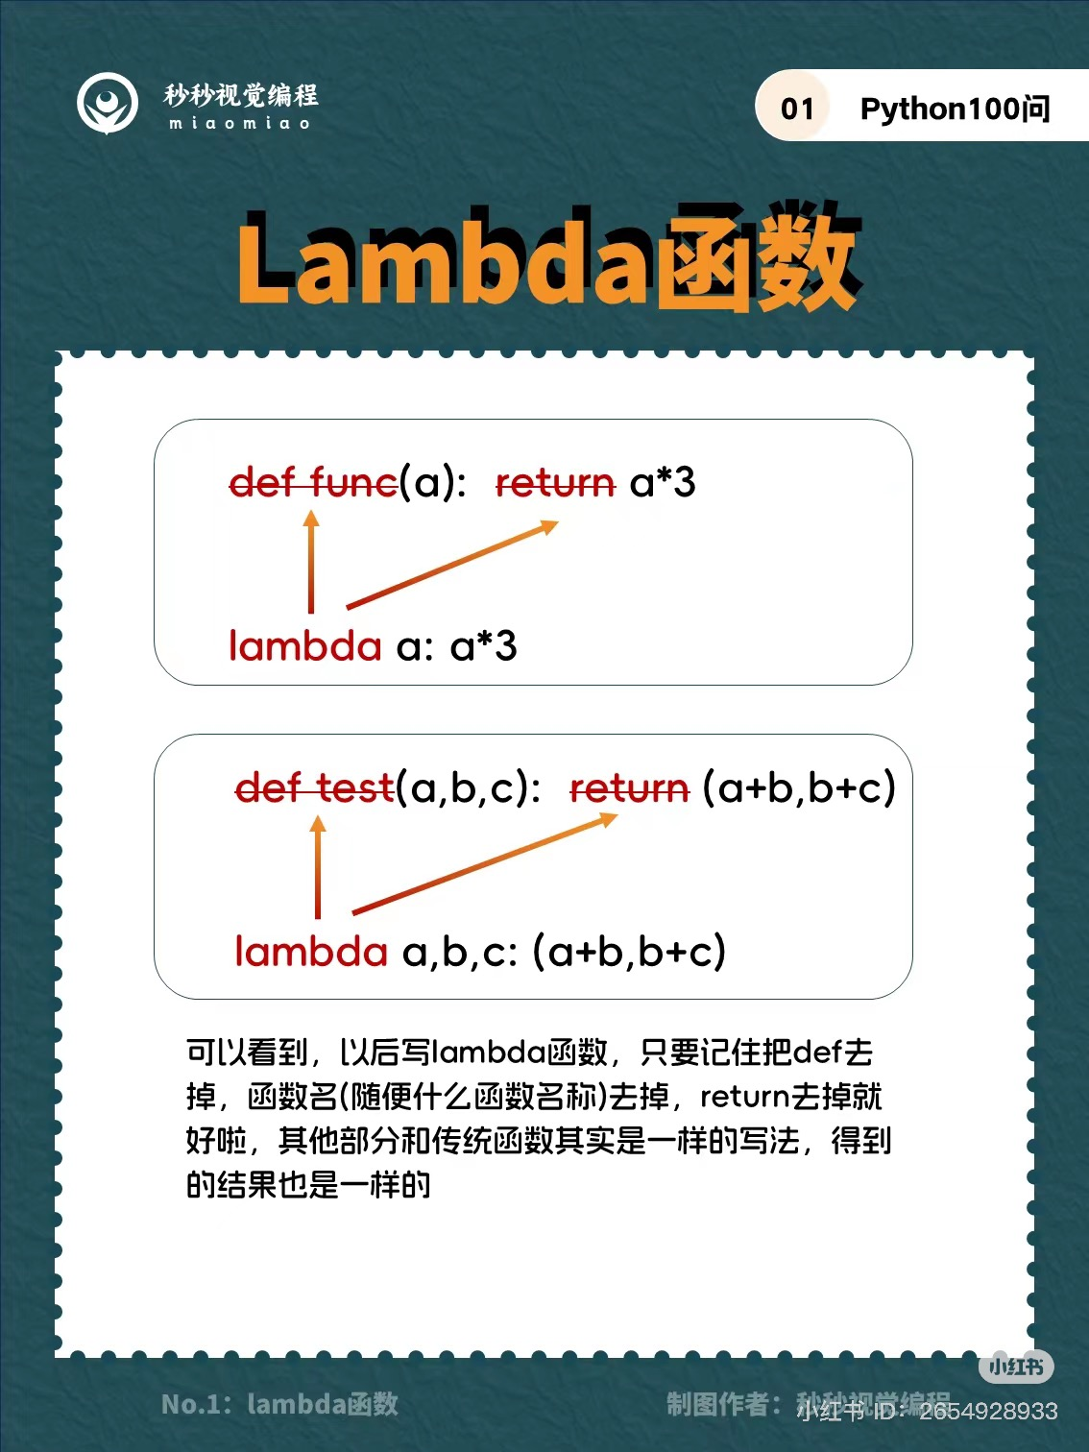
Syntax of Lambda Function in Python
the expression of lambda function is composed of:
The keyword: lambda
A bound variable: x
A body

Slide 5
Differences between lambda and def functions
Syntax:

Slide 6
Differences between lambda and def functions
Return:
Lambda functions implicitly return the result of evaluating the expression
def functions use an explicit return statement.
Scope:
Lambda functions are limited to a single expression.
Def functions can contain multiple statements and have more complex logic.

Slide 7
Lambda Function in Python
handy
anonymous
needed for a short period

Slide 8
Example of usage: Gradebook
PART II

Slide 9
Thank you!

Slide 10
Citation
1. Northeastern CS 5001, homework 5, gradebook, https://northeastern.instructure.com/courses/192162/assignments/2364714?module_item_id=10749754
2. How to Use Python Lambda Functions, by Andre Burgaud, 19 Jun 2019, https://realpython.com/python-lambda/
3. Python Lambda Functions, Last Updated: 20 Jun 2024, https://www.geeksforgeeks.org/python-lambda-anonymous-functions-filter-map-reduce/

